Slide 1
Vector Quantization
Bhuvaneshwari Patil

Slide 2
Unsupervised learning
This type of learning is done without the supervision of a teacher
There would be no feedback from the environment as to what should be the desired output and whether it is correct or incorrect.
In this type of learning the network itself must discover the patterns, features from the input data and the relation for the input data over the output.

Slide 3
Competitive learning for clustering
A form of unsupervised learning in artificial neural networks, in which nodes compete for the right to respond to a subset of the input data
Models and algorithms based on the principle of competitive learning include vector quantization and self-organizing maps (Kohonen maps)
There are three basic elements to a competitive learning rule
A set of neurons that are all the same except for some randomly distributed synaptic weights, and which therefore respond differently to a given set of input patterns
A limit imposed on the "strength" of each neuron
A mechanism that permits the neurons to compete for the right to respond to a given subset of inputs, such that only one output neuron (or only one neuron per group), is active (i.e. "on") at a time.
The neuron that wins the competition is called a "winner-take-all" neuron.

Slide 4
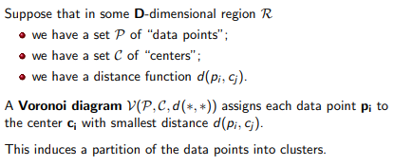
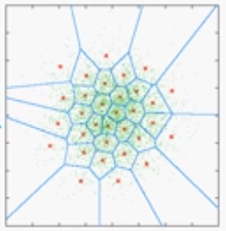
Voronoi tessellation / diagram

Slide 5
What is VQ?
A vector quantizer maps k-dimensional vectors in the vector space R^{k} into a finite set of vectors
Y = {y_{i}: i = 1, 2, ..., N}.
Each vector y_{i} is called a code vector or a codeword
the set of all the codewords is called a codebook.
Associated with each codeword, y_{i}, is a nearest neighbor region called Voronoi region, and it is defined by:

Slide 6
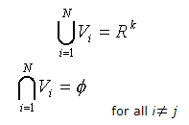
What is VQ?
The set of Voronoi regions partition the entire space R^{k} such that:
As an example we take vectors in the two dimensional case without loss of generality. Figure 1(next slide) shows some vectors in space.
Associated with each cluster of vectors is a representative codeword.
Each codeword resides in its own Voronoi region.
These regions are separated with imaginary lines in figure 1 for illustration.
Given an input vector, the codeword that is chosen to represent it is the one in the same Voronoi region.

Slide 7
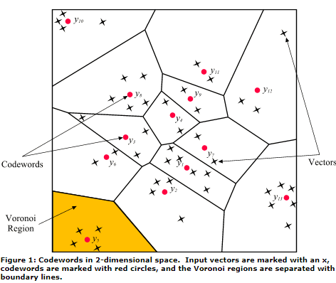
Voronoi diagram for VQ

Slide 8

The algorithm for designing codebook
Determine the number of codewords, N, or the size of the codebook.
Select N codewords at random, and let that be the initial codebook.
The initial codewords can be randomly chosen from the set of input vectors.
Using the Euclidean distance measure clusterize the vectors around each codeword.
This is done by taking each input vector and finding the Euclidean distance between it and each codeword.
The input vector belongs to the cluster of the codeword that yields the minimum distance.
Compute the new set of codewords.
This is done by obtaining the average of each cluster.
Add the component of each vector and divide by the number of vectors in the cluster.
where i is the component of each vector (x, y, z, ... directions), m is the number of vectors in the cluster.
Repeat steps 2 and 3 until the either the codewords don't change or the change in the codewords is small.

Slide 9
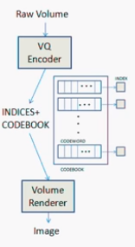
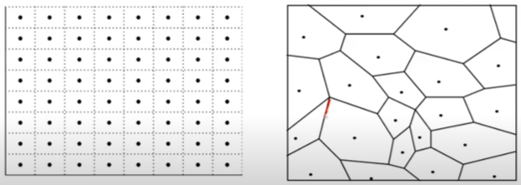
Learning vector quantization
https://www.youtube.com/watch?v=eyWMLmC-9R4
https://www.youtube.com/watch?v=mbS7reecXZg

Slide 10
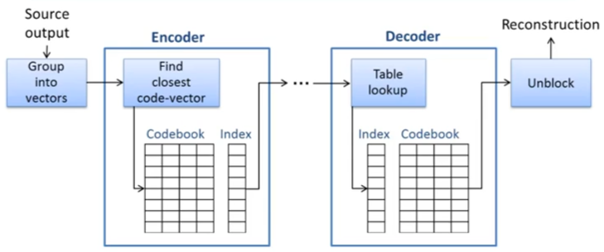
VQ - compression
https://www.youtube.com/watch?v=JmyxDMTpQ4o

Slide 11
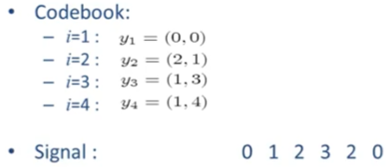

Simple example
Group the signal (2D)
Decode the signal: 0 0 1 3 2 1
Find the Euclidian distance with code book values
Quantization error: 0 -1 -1 0 0 1

Slide 12
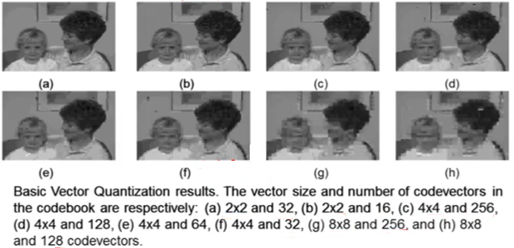
Image compression example

Slide 13
Self-Organising Feature Map
competitive learning algorithm
proposed by Teuvo Kohonen in 1988
feature mapping
the relative locations of the neurons in the network
the neurons are arranged in a grid with connections between the neurons
rather than in layers with connections only between the different layers

Slide 14
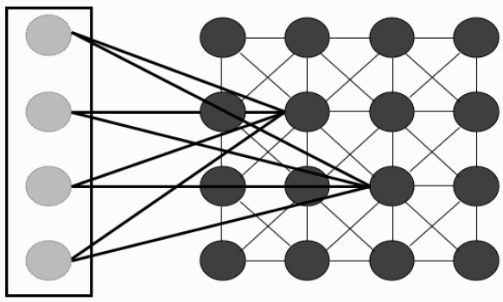
The Self-Organising Map network

Slide 15
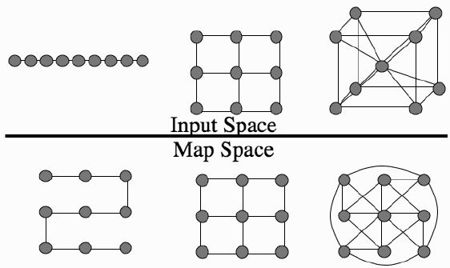
Sample SOM
When inputs in 1D (a straight line), a 2D grid, and a 3D cube are represented by a 2D grid of neurons, the relative ordering is not perfectly preserved.
The 1D line is bent, which means that points that used to be a long way apart (such as the first and sixth on the line) are now close together, while the cube becomes very omplicated.
The lines in the bottom part of the figure represent connections that are meant to be close.

